Slide 1
Undulator 1 Pulsed-wire alignment

Slide 2
Wire Position 1
x1,y1 denote positions of post on entrance side. X2,y2 denote positions of post on exit side.
X1,y1 = (12, 18)
X2, y2 = (11, 12)
Use “xtraj vs yoffset” and “ytraj vs xoffset” wirescans to measure magnetic axis along undulator
Use velocity signal (flat) to calibration amplitude vs voltage.

Slide 3
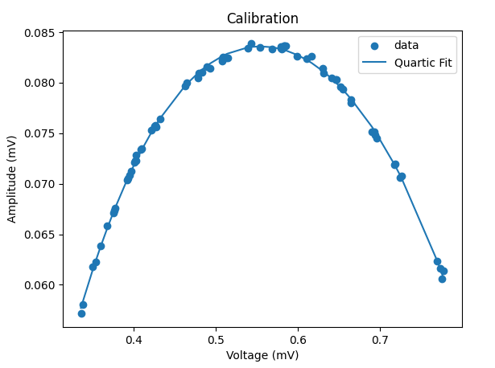
Calibration
Non-flat trajectories will sample voltages outside the linear region.
Calibration curve allows us to correct for this error afterwards.
Error in calibration data is <0.5%

Slide 4
Frequency Lowpass Filter
One laser/photodiode pair has a very large signature at 50kHz.
I have implemented a low pass filter where frequencies above a specified cutoff are set to zero amplitude.
This introduces noise near the edges of the signal
1-2 percent of full window
Doesn’t affect measurement in the middle.

Slide 5
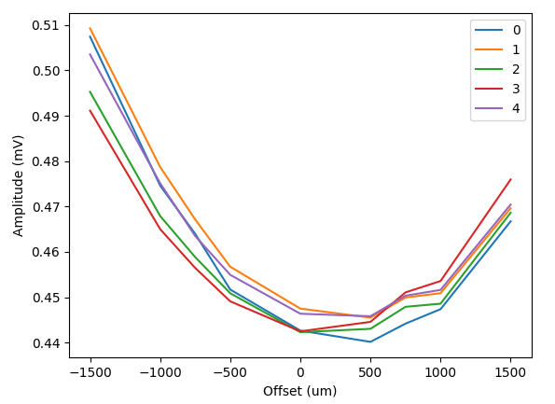
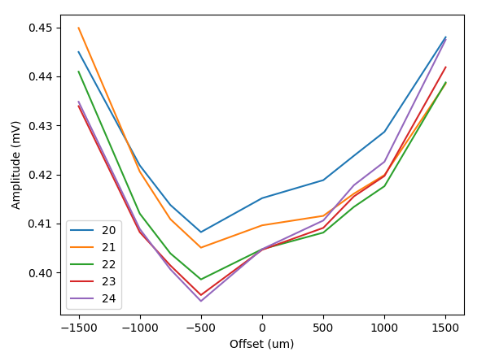
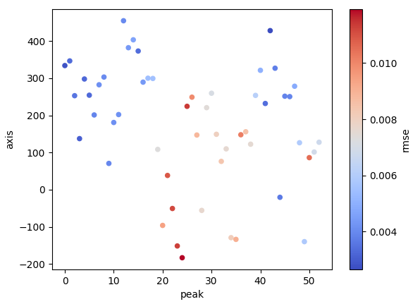
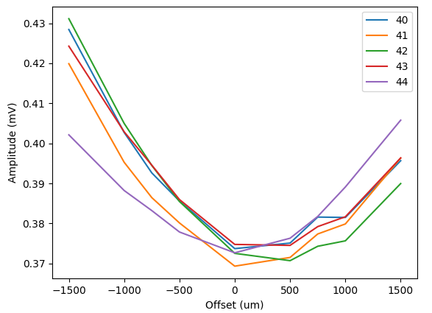
Dec 19: Xtraj vs Yoffset
First 5 peak concavities look very nice!
Graph shows magnetic axis along undulator with color showing the error in quadratic fit.
Fit with line, weights given by 1/rmse
Suggested wire adjustment:
yP1 = 470um
yP2 = 100um

Slide 6
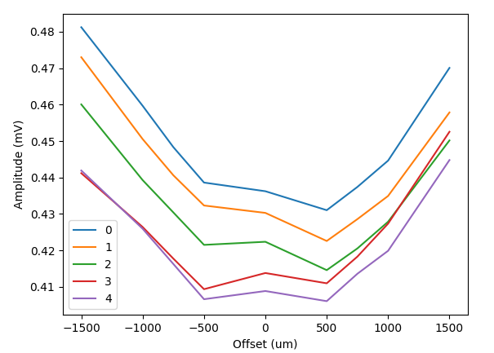
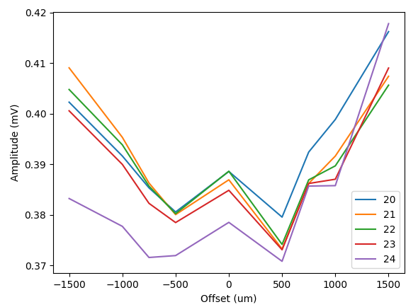
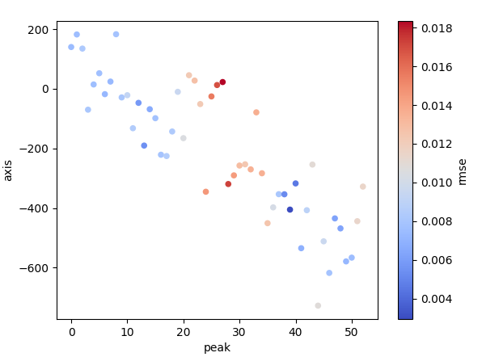
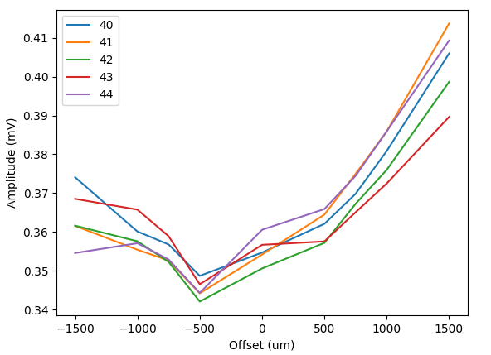
Dec 21: Ytraj vs Xoffset
Nice linear trend for magnetic axis vs xoffset.
Suggested wire adjustment:
xP1 = 970um
xP2 = -850um
Not surprised there is more noise
Noise to signal ratio was 3x larger than for xtraj.
Should these results be trusted?

Slide 7
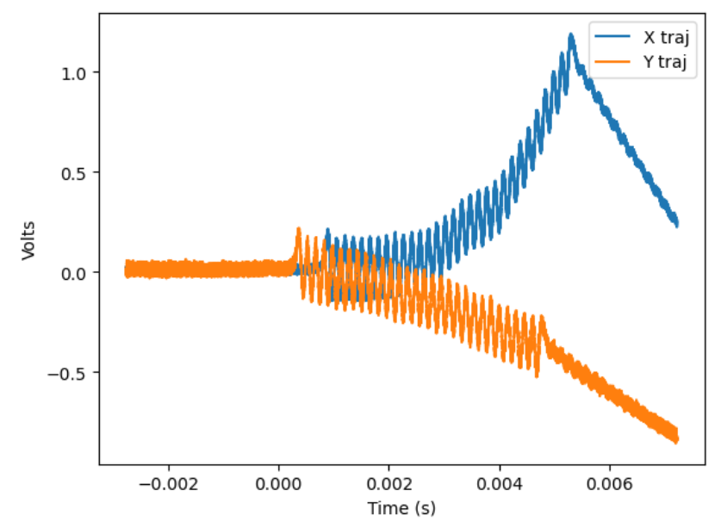
Wire Position 2
Old Positions:
X1,y1 = (12, 18)
X2, y2 = (11, 12)
Adjustments:
xP1 = 970um
yP1 = 470um
xP2 = -850um
yP2 = 100um
New Positions:
X1,y1 = (12.97, 18.47)
X2, y2 = (10.15, 12.10)
Trajectories after moving to new location
Y trajectory looks good
X trajectory has a little concavity for first 60% of undulator. I do not like the kick around t=4ms…

Slide 8
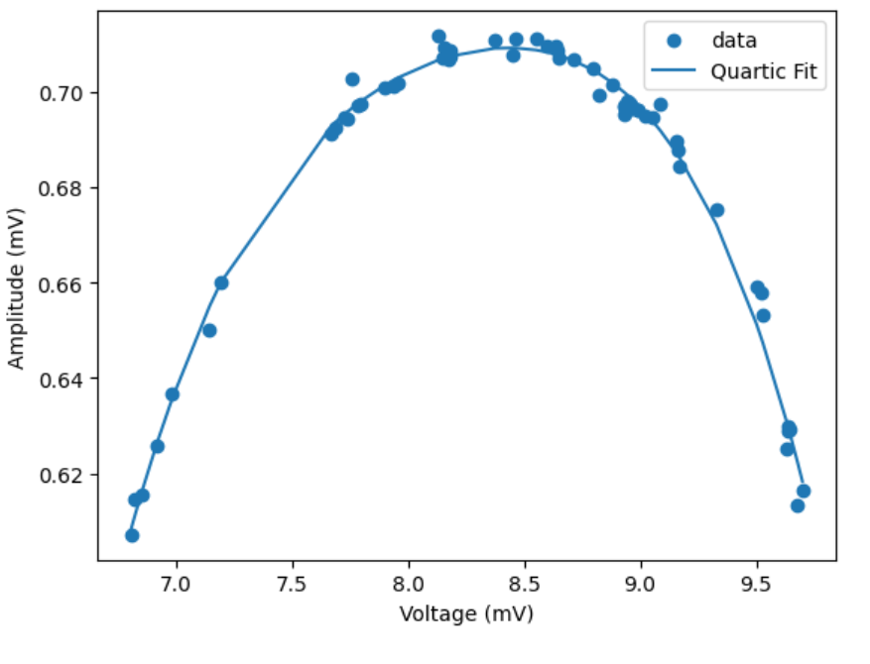
Dec 21: Xtraj vs Xoffset
Have to tune trajectory straightish with entrance magnet to have measurement be feasible.
Tried again, still failed to get good results

Slide 9
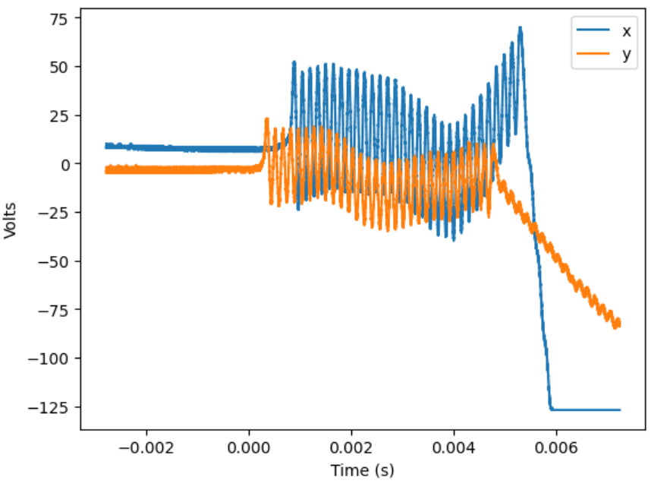
Straighten X manually
Old Positions:
X1,y1 = (12.97, 18.47)
X2, y2 = (10.15, 12.10)
Adjustments:
xP2 = 1.0
New Positions:
X1,y1 = (12.97, 18.47)
X2, y2 = (11.15, 12.10)
My impression playing around the x position at both posts is that the kick at t=4ms is not being fixed, just masked..
What do we do about this…

